Slide 1
Creativity & Innovation
BM006-3-2-CRI (VC1) 1st April 2018
Lecture 3:
Problem solving

Slide 2
Topic Learning Outcomes
To develop lines of argument in problem solving
To make sound judgement in accordance with basic theories and concepts in;
  Objective finding
  Fact finding
  Problem finding
  Idea generation
  Solution finding
  implementation

Slide 3
Problem solving - definition
Directed thinking towards a goal solution – the task is to choose the best process that will lead to a goal
1st psychological studies by Wolfgang Kohler (insightful learning)

Slide 4
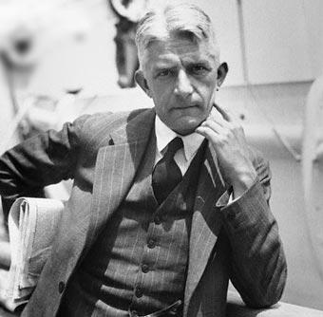
In the 1920s, German psychologist Wolfgang Kohler, German-American psychologist was studying the behavior of apes. He designed some simple experiments that led to the development of one of the first cognitive theories of learning, which he called insight learning.

Slide 5
The psychologist gained fame with his studies on cognitive processing involved in problem-solving by animals. His tests in Tenerife in the 1910s with chimpanzees suggested that these animals solved problems by understanding – like human beings, instead of going through
  trial and error process
  stimulus response association
Praveen Shrestha, "Insight Learning," in Psychestudy, November 17, 2017, https://www.psychestudy.com/behavioral/learning-memory/insight-learning.

Slide 6
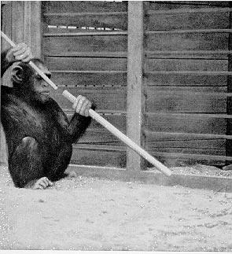
Köhler placed a chimpanzee named Sultan inside a cage. Sultan grew hungry and a bunch of banana was placed just outside the cage. Sultan was provided with one long and another short bamboo stick. Neither of the sticks could reach the banana alone and the only possible way to reach the banana was to join the two sticks.
Initially, Sultan showed all customary reactions that a chimpanzee shows inside a cage, and gradually tried to draw the banana towards him with the sticks. After countless fruitless efforts, Sultan nearly gave up, but as he was playing with the sticks, he managed to touch the banana by pushing a stick with another stick. Sultan accidentally managed to join the two sticks and with its help, it pulled the banana inside the cage.
https://www.youtube.com/watch?v=6-YWrPzsmEE

Slide 7
Insight learning refers to the sudden realization of the solution of any problem without repeated trials or continuous practices.
Insight learning is the type of learning, in which one draws on previous experience and also seems to involve a new way of perceiving logical and cause-and-effect relationship.

Slide 8
Four Characteristics
1. problem solving is goal directed
2. it involves a series of operations
3. it involves cognitive processes
4. it involves sub-goal decomposition - reaching overall goal requires reaching sub-goals

Slide 9
3 Steps in Problem Solving
Representing or defining exactly what the problem is to solve
Generating possible ways of solving the problem and choosing the best solution
Evaluating the solution – is it the best solution?

Slide 10
Common Errors in Problem Solving
1. Inaccuracies in reading
  Reading material without fully understanding the material
  Reading the material too fast
  Missing words or misreading words because you are not reading completely
  Failing to reread difficult passages

Slide 11
Common Errors in Problem Solving
Inaccuracy in thinking
  Placing more importance on speed or ease of obtaining an answer rather than accuracy
  Not being careful to perform needed operations accurately
  Being inconsistent in the way problems are interpreted and solved
  Not checking the accuracy of a solution
  Drawing a conclusion in the middle of the problem without sufficient thought
  Working too quickly results in the above errors

Slide 12
Common Errors in Problem Solving
Weakness in problem analysis
  Trying to solve the whole problem without breaking it down into sub-goals
  Failing to use prior knowledge and experiences
  Skipping difficult material or unfamiliar words, etc.
  Not properly constructing a representation of the ideas presented in the problem

Slide 13
Common Errors in Problem Solving
Lack of perseverance
  Making a weak attempt to solve the problem – lack of confidence?
  Choosing an answer quickly because it looked or felt right instead of fully analyzing the problem
  Jumping to a conclusion halfway through the process

Slide 14
Proficient Problem Solvers
Have a positive attitude – confident
Great concern for accuracy
Break problems into parts that can be accomplished
Avoid guessing and jumping to conclusions
More active – do more things and put in more effort

Slide 15
Improving Problem Solving Ability
1. Increase knowledge base – experts have more efficient methods for problem solving
2. Automate some components through expertise
3. Follow a systematic plan of attack
4. Draw inferences from information given and memory
5. If solution not obvious look at possible heuristics
6. Reformulate problem – have you defined the problem correctly
7. Draw a picture

Slide 16
Creativity
Definition – a cognitive activity that results in a new or novel way of viewing a problem or situation
Involves the ability to avoid the traps of problem solving:
  Mental sets
  Functional fixedness
  Misrepresentation of the problem

Slide 17
The Process of Creativity
Stage 1: Preparation – knowledge acquisition and developing and testing possible solutions
Stage 2: Incubation – getting away from the problem can lead to creative solutions – doesn’t always occur
  Insightful learning
  Non-insightful learning
Stage 3: Illumination – sudden discovery of a solution
Stage 4: Verification – evaluation of the insight; does it really solve the problem or is it he best solution

Slide 18
Characteristics of a Creative Person
1. Knowledgeable and intelligent
2. Personality – self-confident and not afraid to be wrong or look foolish
3. Motivation – willing to make the cognitive investment and effort to develop a solution

Slide 19
Environmental Influences on Creativity
If creativity is valued in the cultural setting, motivation to be creative increases
When practical constraints are put on creative thinking, low creativity
  Practical evaluation of creative ideas occurs early – restricts the ideas that can be produced
  Thinking about completely impractical ideas can lead to less impractical ideas which can lead to practical innovative ideas
  Individual production of ideas produce more creative ideas than group production

Slide 20
Measuring Creativity
Most people know who a creative person is, but creativity is difficult to measure
Frequent procedure involves divergent thinking – How many uses for a brick can you think of?
Problem is that evaluating possible solutions just as important as generating

Slide 21
Which is it?
Creativity
The process of generating something new that has value.
There are many new ideas, but some may not have value.
Innovation
The process of creating something new.
It has significant value to an individual, group, an organization, society, or an industry.

Slide 22
Creative environment
“The question isn’t whether you want more creative employees; you’ve already got them. The real question is whether you’re going to recognize their creativity and figure out how to use it better.”
—Stan Gryskiewicz,
The Center for Creative Leadership

Slide 23
Question and answer session
Q & A
Slide <<number>> of 13

Slide 24
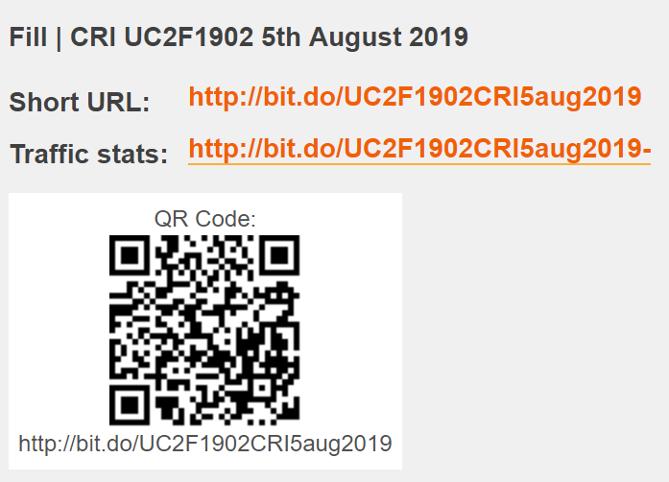

Attendance

Slide 25
What we will cover next
To evaluate and interpret different concepts and principles in idea generation.
  Attribute listing
  SCAMPER
  Fishbone
Slide <<number>> of 13

Slide 26
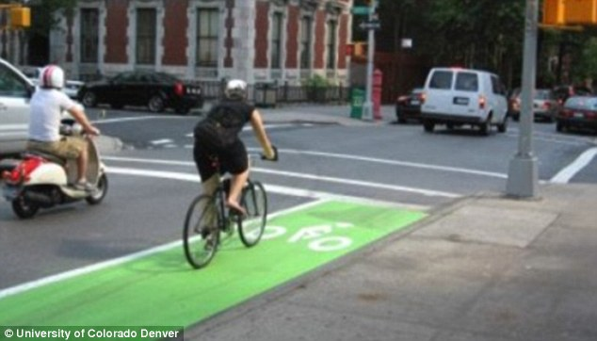
Activity
Issue - Is living in suburbs making you fat?
Living in a suburb could be putting you at risk of obesity and even heart disease.
Contradictory to the view that living in rural spaces makes you fitter and healthier, researchers have discovered it can actually increase the rates of these diseases.
They found that the more compact an area is, and the lower the number of intersections or road junctions it has, the lower the chances of diabetes and heart disease.
Read more: http://www.dailymail.co.uk/sciencetech/article-2724023/Are-green-spaces-parks-making-FAT-Health-data-suggests-open-communities-leads-higher-obesity-rates.html#ixzz3At6Pfhr3

